Slide 1

TARGET FINANCIAL
ANALYSIS
Timille Tingle
Lamar University
Finance 5300

Slide 2
PROJECT OVERVIEW
Economic Analysis
Capital Market Analysis
Industrial Analysis
Company Analysis
Management
Balance and Income Statement Analysis
Qualitative Analysis
Ratio Analysis
Final Evaluation

Slide 3
ECONOMIC ANALYSIS
International Level
International economic aspects have grown over the years, making Target expand and succeed globally
Target has influenced over 37 million people in the global market according to 2019 reports
The economic growth rate in Canada has hit over 1.4% with a GDP per Capita of $46,313

Slide 4
ECONOMIC ANALYSIS
National Level
The economy of US market has enabled growth of Target locally and nationally
The economy of the US has grown with the national GDP per capita of $62,794
The retail industry promote up to over 5 million employment opportunities
Target offers 360,000 of this employment opportunities
Notes:
The United States national economy favors the demand for household goods. Just as other regions are developing economically, the United States economy also has developed with the national GDP and the per capita over years. According to reports from 2018, the GDP per capita was $62794 which has steadily improved over years. Most people in the United States local retailers to exports. Most retail products required in day to day life in the United States are provided by local retailers.
The retail industry in the United States is responsible for over $5 trillion annual revenue generated through sales in the United States. This has improved over the years with general merchandise sales being higher than other products. The retail industry is also a major employment source for over 5 million people in the United States who work in retail sales. Target has over 360,000 employees. As the target is one of the top retailers in the nation, it attracts some of the best employees which have influenced efficiency in operations.

Slide 5
National Economic Analysis
#
5
6
7
8
1
1
1
1
0
0
0
0
2
2
2
2
1
2
3
4
1.2
National level
1.2.1
Population
35.986
36.885
36.96
37.31
MILLION
MILLION
MILLION
MILLION
1.2.2
Description and characteristics of the national
economy, the main sectors of the economy
Canada is the 10th largest GDP by nominal and
1
world. Canada is among developed countries i
n
and oil industries is Canada m
o
1.2.3
Political and other national factors that affect on
financial and economic growth of country.
Canada econimic system is generally combined
w
public enterprises. In 2018 Canada trade goods
dollars.

Slide 6
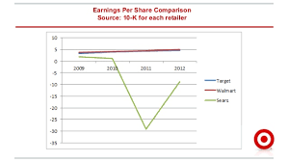
CAPITAL MARKET ANALYSIS
BONDS MARKET
USA has the leading corporate bond
market in the world with over
$1.7 trillion
Through investor protection,
transparency and safety, safety adoption
measures have enabled increased
investments and opportunities for growth
of Target.
https://www.google.com/imgres?imgurl=https%3A%2F%2Fimage.slidesharecdn.com
Notes:
The United States capital markets are significant to the economy of the United States. The capital markets are highly liquid and deep with high efficiency indicated by the large part of domestic gross product generated from the commercial sector. The United States has the leading corporate bond market in the world with over $1.7 trillion issued by companies incorporated in corporate bonds. There has been a high history of success in capital markets in the U.S to a regulatory structure that ensures protection to investors, transparency,fmkds, and safety. The United States has adopted different regulations over the years which affect the structure of the capital markets. The financial regulatory system is evaluated regularly as a way of strengthening the capital markets and establishing ways of supporting the markets and increasing investments and opportunities for growth.

Slide 7
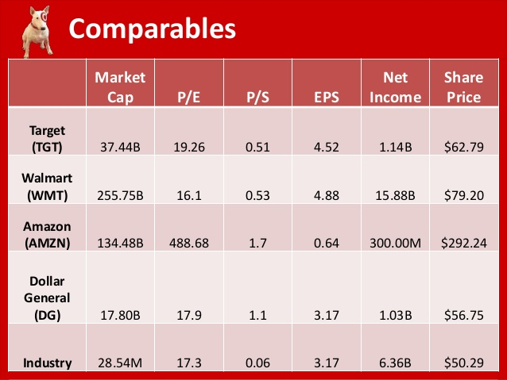

INDUSTRIAL ANALYSIS
Target operates a retail industry valued at $23 trillion with over 5% increase rate
By the year 2023, the value of the retail industry is expected to be over $31 trillion selling a variety of retail products.
The industry further accounts for over two-thirds of the national GDP
Notes:
Target operates in the retail industry which is one of the most competitive industries locally and globally. The retail industry is valued at over $23 trillion with over a 5% rate of increase over time. By the year 2023, the value of the retail industry is expected to be over $31 trillion. A wide variety of products is offered by the retail industry including food items, furniture, and other products essential for daily lives. The health of the retail market in the United States has been influenced by the development of the national economy and in return, the retail industry accounts for over two-thirds of the national GDP. The retailed industry has matured over time with major retailers like Target, Amazon, and Costco introducing online shopping.

Slide 8

COMPANY ANALYSIS
Company Overview
Target is one of the top retail shops in the US and named No. 37 largest corporation.
Its target stores ranges every 10
miles for about 75% of the
population
There are over 1884 stores across
America and 42 Distribution centers
there are also cooperate global
offices in over 20 locations
Notes:
There several Target stores in every state in the country with a target store within every 10 miles for about 75% of the population. There are over 1884 stores in the United States and 42 distribution centers. The corporation has global offices in over 20 locations. The company has its headquarters at Minneapolis, Minnesota where the company established its first stores. The company then expanded its operations all over the country setting up 1884 stores by today. Currently, Target is among the top 10 retailers in the United States and named No. 37 in the list of the United States' largest Corporations in 2020.

Slide 9
2019 financial report indicate that the company generates over $75356 billion in sales revenue from different categories of company products
The company enjoys over other retailers due to its pricing strategies
It attracts and offers over 300,000 job opportunities since 2016
The company has over 500 million shares according to the recent financial reports.
Notes:
The low prices and product differentiation attract a wide range of customers whose needs can be met by a wide variety of products. The company also enjoys customer loyalty due to its pricing strategy which gives it a major competitive advantage over other retailers. It attracts some of the best employees in the retail industry offering over 300000 job opportunities since 2016. Currently, the company has 360,000+ employees working in different departments of the corporation. The company has over 500 million shares according to the latest's financial disclosure.

Slide 10

Company Management
The company is headed by Board of Management responsible for making major decisions. They are;
Brian Cornell
CEO and Chairman, BOD
He overseas the company’s operations
in all local and global stores

Slide 11


Company Management
John Mulligan Michael Fiddelke
Chief Operations Executive Vice Financial Officer
Number of Employees is 360,000 as at 2019

Slide 12
COMPANY LIFECYCLE
Long term Outlook
Target Corporation has a positive long-term outlook. The company's value has improved over years at a steadily increasing rate. The company's leadership and decision making are in the hands of the board of directors who make a major decision in the organization. With the current leadership, the company is expected to improve in performance over the years.
Notes:
Target Corporation has a positive long-term outlook. The company's value
has improved over years at a steadily increasing rate. The company's leadership and decision making are in the hands of the board of directors who make a major decision in the organization. With the current leadership, the company is expected to improve in performance over the years.

Slide 13
SIMPLE BALANCE SHEET
Assets Liabilities
1st Year 2873768 1st Year 771534
2nd Year 37431000 2nd Year 12708000
3rd Year 3414449 3rd Year 1236523
4th Year 41290000 4th Year 29993000
5th Year 3321718 5th Year 1352698
                Total Equity
1st Year 20999234
2nd Year 10953000
3rd Year 1867926
4th Year 11297000
5th Year 1144783

Slide 14
SIMPLE INCOME STATEMENT
Revenue Cost
1st Year 3322517 1st Year 3133484
2nd Year 69495000 2nd Year 48872000
3rd Year 2496559 3rd Year 2638050
4th Year 75356000 4th Year 53299000
5th Year 2485145 5th Year 2994
Net Income
1st Year 149337
2nd Year 2737000
3rd Year -
4th Year 2937000
5th Year -

Slide 15
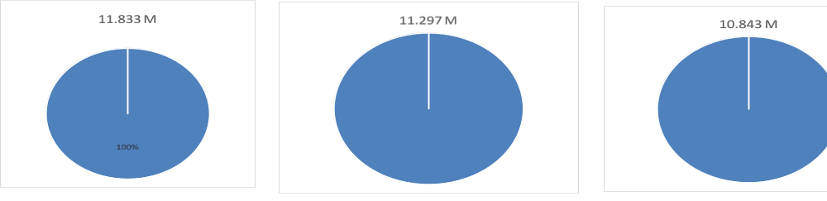
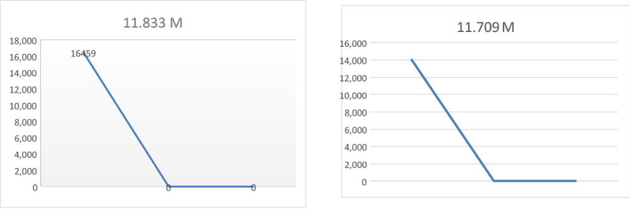
BALANCE SHEET
Structure of Liabilities
Structure of Liabilities

Slide 16
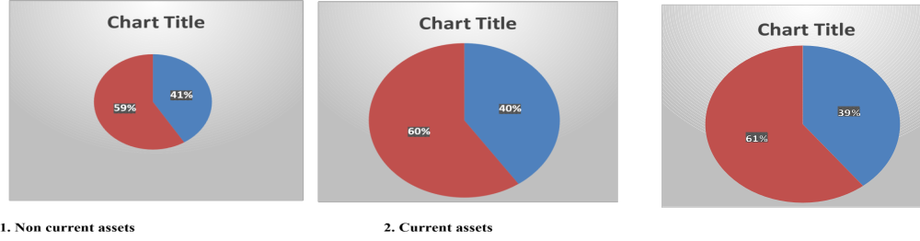
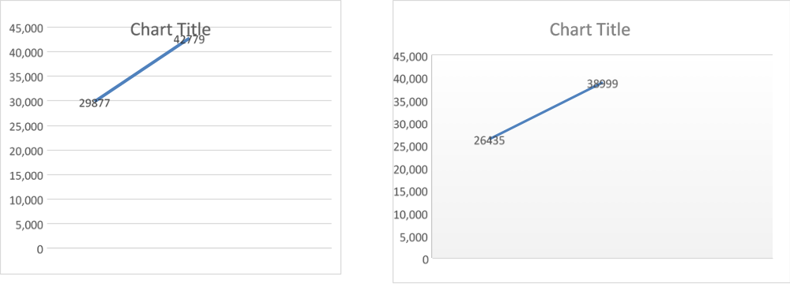
BALANCE SHEET
Comparative Analysis
Structure of Assets

Slide 17
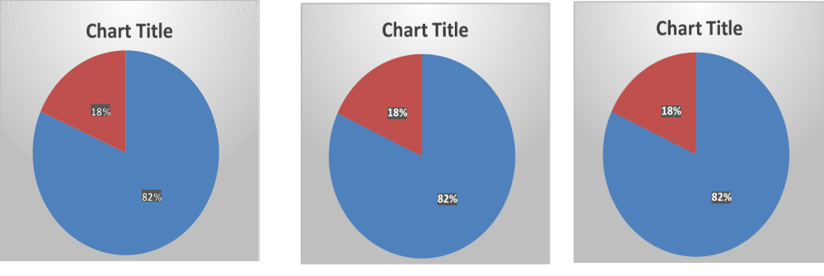
INCOME STATEMENT
Structure of Cost

Slide 18
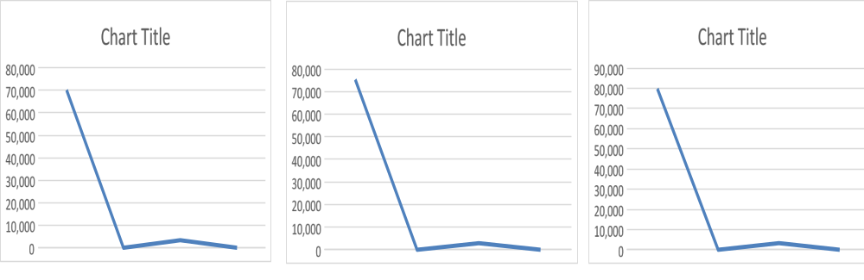
INCOME STATEMENT
Comparative Analysis
Series 1 – Revenues Series 2 - Expenses Series 3 - Net income

Slide 19
FINAL EVALUATION
The success of target indicates high levels of revenue from the company's operations in several stores
Stock prices has also improved indicating the Company’s success as it progresses
The growth of the company’s market over years has attracted potential investors.

